Slide 1

Prescription Drugs
Listed and Unlisted Side Effects analysis using Twitter
Jigyasa Sachdeva, Karansinh Raj, Marta Turowski, Pawan Chawla

Slide 2

Objectives
Using tweets related to 8 common prescription drugs: 1. Analyze proportion of listed side effects 2. Identify unlisted side effects

Slide 3
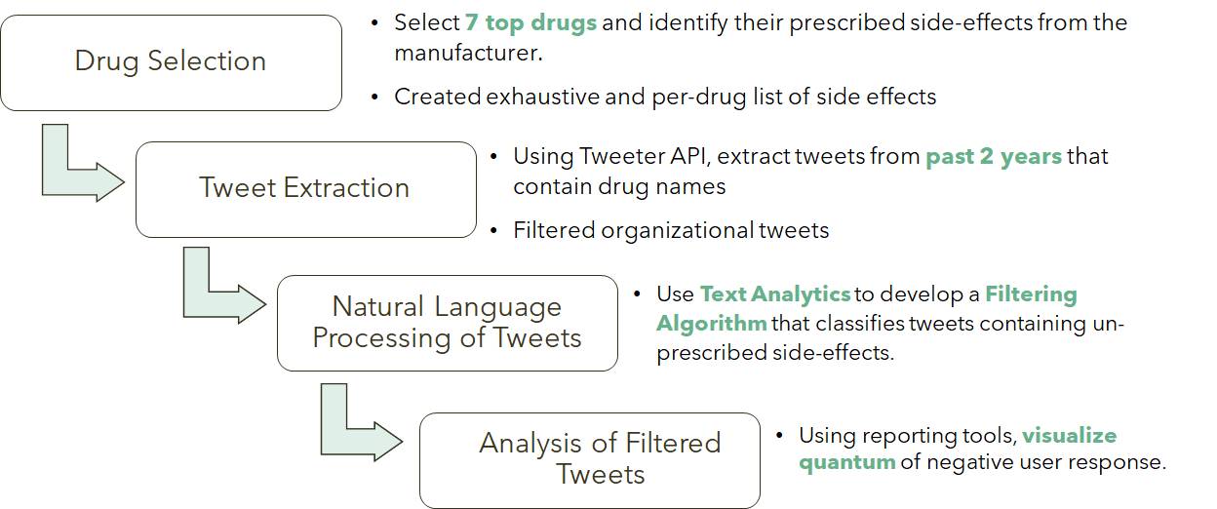
Action Plan

Slide 4
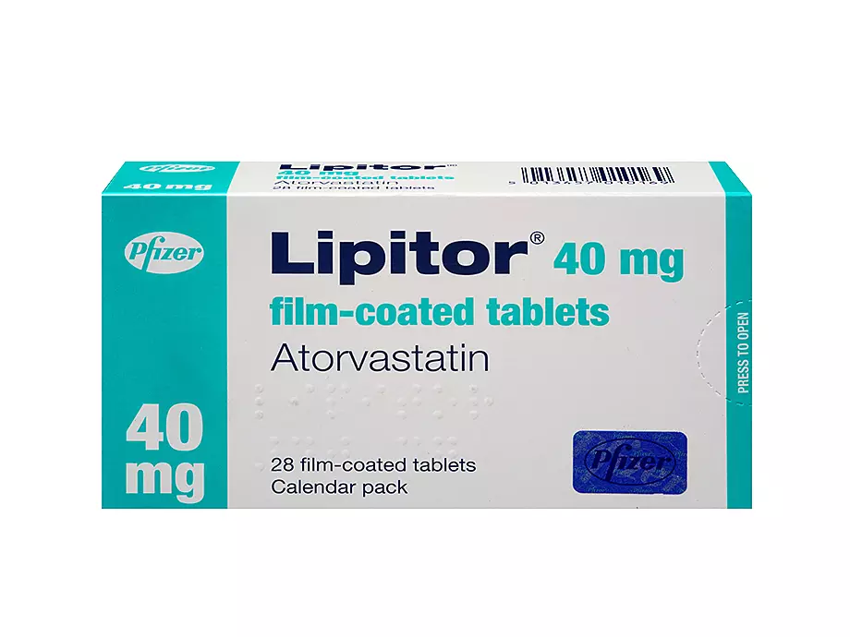
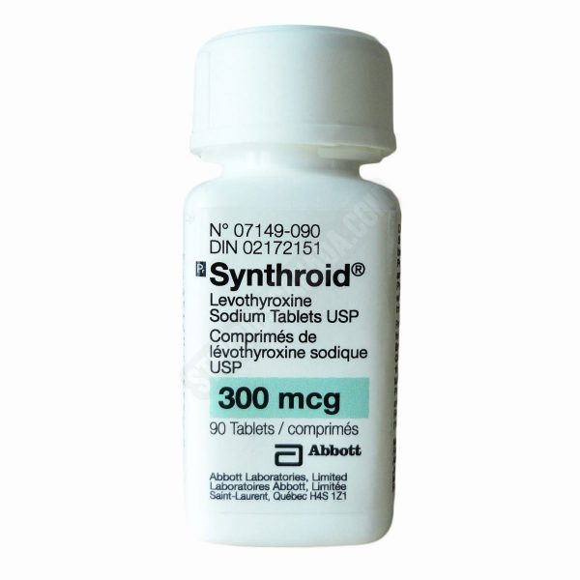
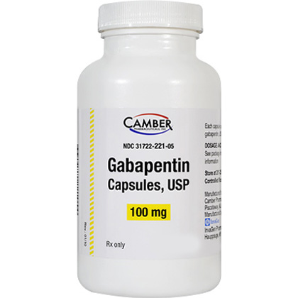
7 Prescription Drugs
Drug Name | Side Effects | Image
Lipitor/ Atorvastatin Use: Cholesterol lowering drug Brand names: Atorvastatin-40; Atorvastatin-80;Auro-Atorvastatin; BIO-Atorvastatin etc. | Arthralgia, Limb pain, Nasopharyngitis; Hemorrhagic stroke; Urticaria, bullous rash, Diabetes mellitus, hyperglycemia, Nausea, dyspepsia, Urinary tract infection, Increased serum transaminases, Blurred vision, Fever, alopecia etc.
Levothyroxine/ Synthroid/ Levoxyl Use: Thyroid Hormone Replacement Brand names: Euthyrox, Levoxyl, Synthroid, Tirosint etc. | Angina pectoris, cardiac arrhythmia, Anxiety,emotional lability, Alopecia, diaphoresis, Goiter, menstrual disease, Reduced fertility, muscle spasm, Dyspnea etc.
 | drowsiness, ataxia, fatigue, Viral infection, Peripheral edema, jaundice, Skin rash, excoriation, Weight gain, Fever, anaphylaxis, respiratory depression, Tremor, asthenia, Seasonal allergy etc
Gabapentin/Neurotin/Gralise Use: Pain medicine (non-classical narcotic) and Epilepsy Medicine Brand names: Gralise; Starter;
Neurontin

Slide 5
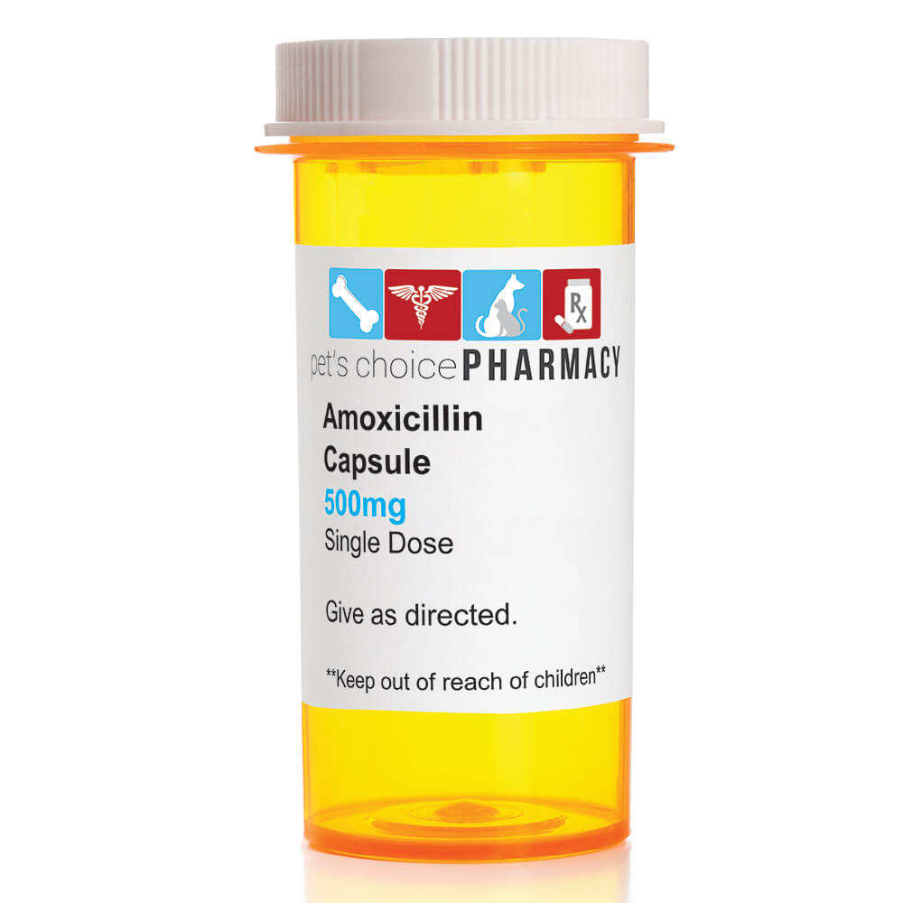
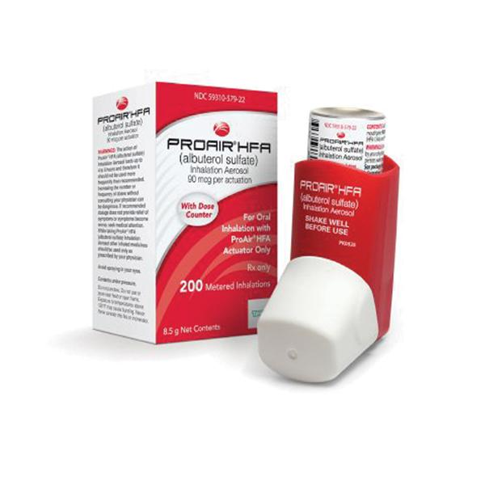
Amoxicillin Use: Penicillin based antibiotic Brand names: Amoxil, Moxatag etc | Headache, Agitation,anxiety, behavioral changes,, Diarrhea, nausea, vomiting, Clostridioides difficile associated diarrhea, hemorrhagic colitis,melanoglossia, mucocutaneous candidiasis, staining of tooth, abdominal pain, Acute generalized exanthematous pustulosis, erythematous maculopapular rash, erythema multiforme, exfoliative dermatitis, toxic epidermal necrolysis, urticaria etc
Albuterol Use: Asthma rescue drug for bronchospasm Brand names: Ventolin, Proair, Proventil, Accunen etc | Excitement, nervousness, Headache,Shakiness, Tremor , Upper respiratory tract infection, rhinitis, bronchospasm, pharyngitis, exacerbation of asthma, Tachycardia, hypertension, chest pain, palpitations, angina pectoris, atrial fibrillation,peripheral vasodilation, supraventricular tachycardia, Shakiness, headache, anxiety, ataxia, depression, drowsiness, rigors, voice, muscle spasm,Agitation,anxiety etc

Slide 6


Sertraline Use: SSRI, depression medicine Brand names: Zoloft | Decreased libido, weight loss, diabetes mellitus, galactorrhea, Hypercholesterolemia, Hypoglycemia, hypothyroidism, diabetes mellitus, hyperglycemia, hyperprolactinemia,pancreatitis, coagulation time increased (altered platelet function), leukopenia, pancytopenia, thrombocytopenia, Anaphylaxis etc
Warfarin Use: blood thinner - prevents blood clots Brand names: Coumadin | Bleeding, Major or minor hemorrhage, Purple-toe syndrome,systemic cholesterol micro- embolism, vasculitis, Alopecia, bullous rash,dermatitis, pruritus, skin necrosis,Urticaria, vascular calcification (calcium uremic arteriolopathy and calciphylaxis) etc

Slide 7

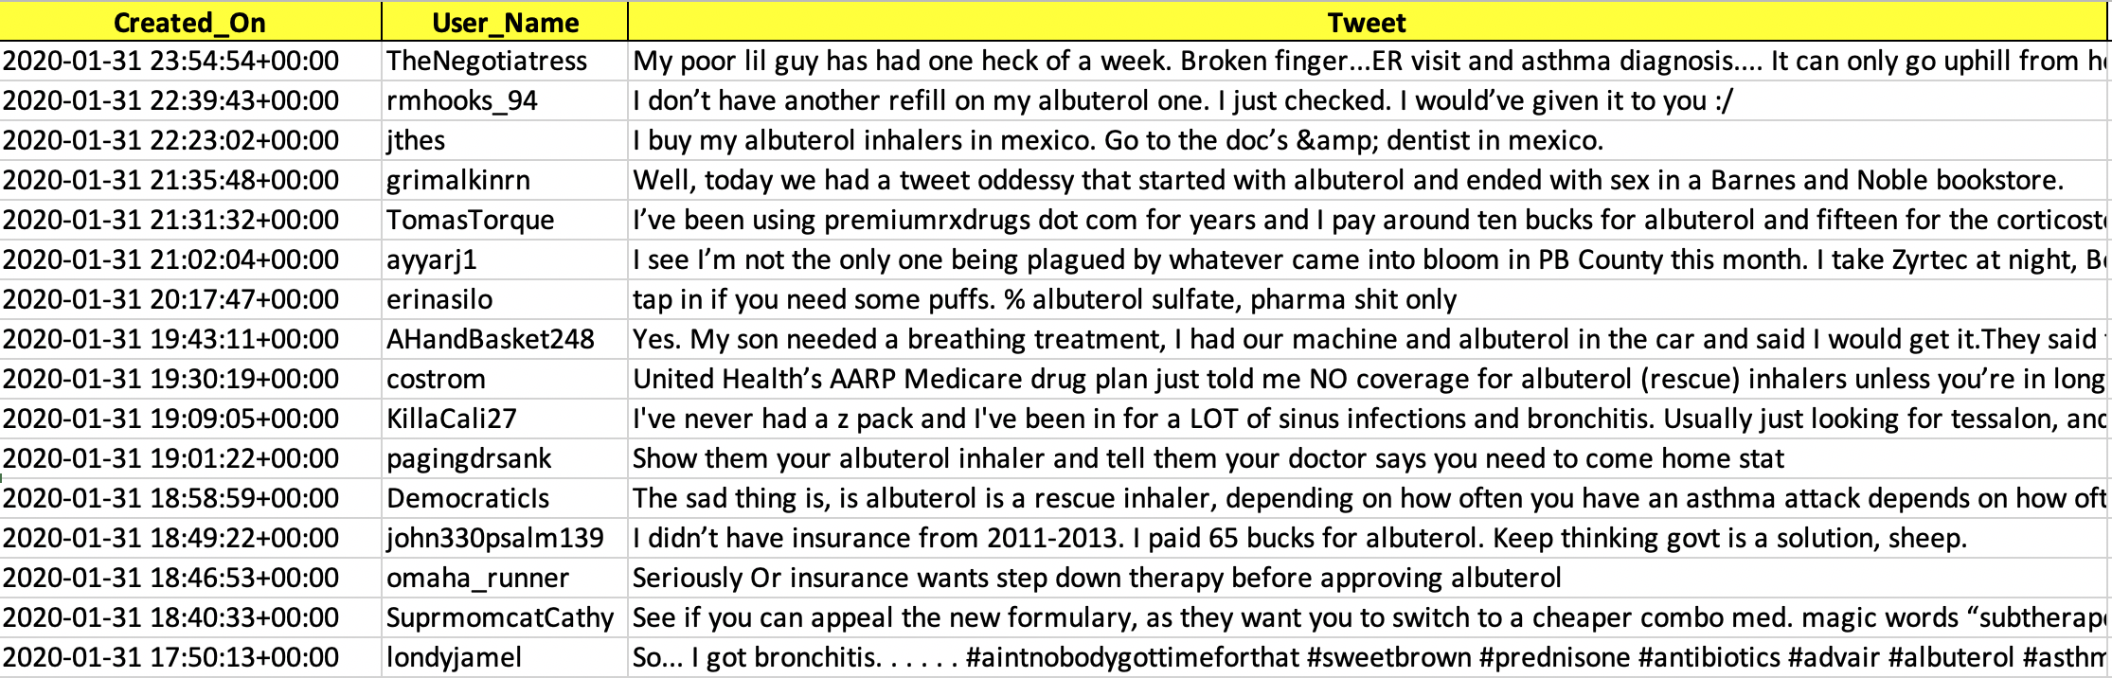
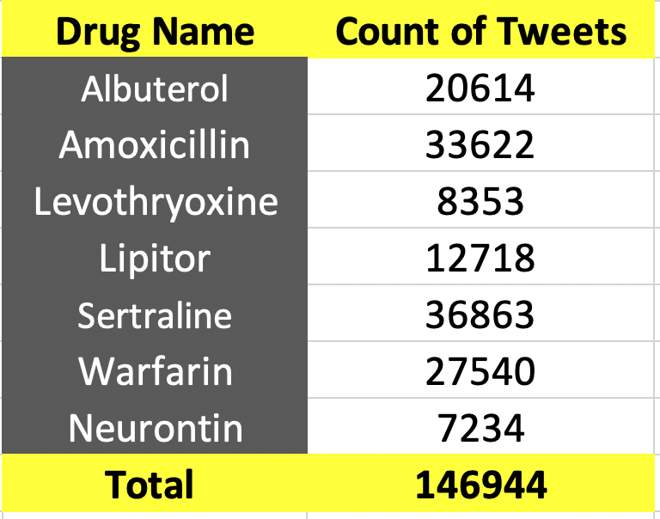
Collecting Tweets
Function used- getoldtweets (GOT3) Query Parameters- Search based on: Drug name OR common name OR brand names, - Duration of tweets: May 2017 to Feb 2020 - Language: English
Snapshot for tweets related to Albuterol
Frequency of tweets per drug

Slide 8
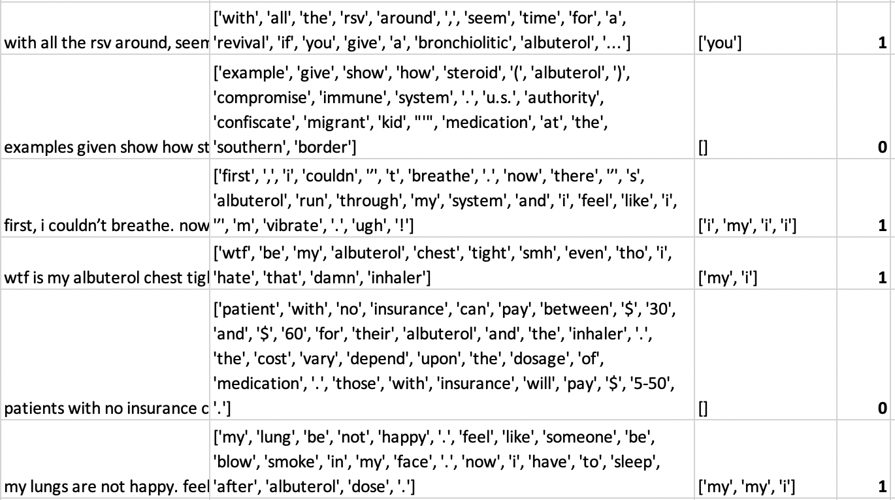
Filtering Organizational Tweets
Identifying personal tweets to filter organizational tweets
Collected personal-pronoun words from: https://www.kovcomp.co.uk/wordstat/LIWC.html
Lower-cased the tweets, tokenized and lemmatized to clean the dataset
Extracted the tweets which contained these words Flagged as ‘1’ in the dataset

Slide 9

Pre-Processing of Tweets
Converting the original tweet string to a processed tweet string by applying the following operations:
Tokenize each word per string,
Convert to lower-case,
Remove the hashtags,
Strip the punctuation,
Remove double-spacing (if any),
Remove stop-words,
Fix-word length,
Join processed tokens to processed string

Slide 10
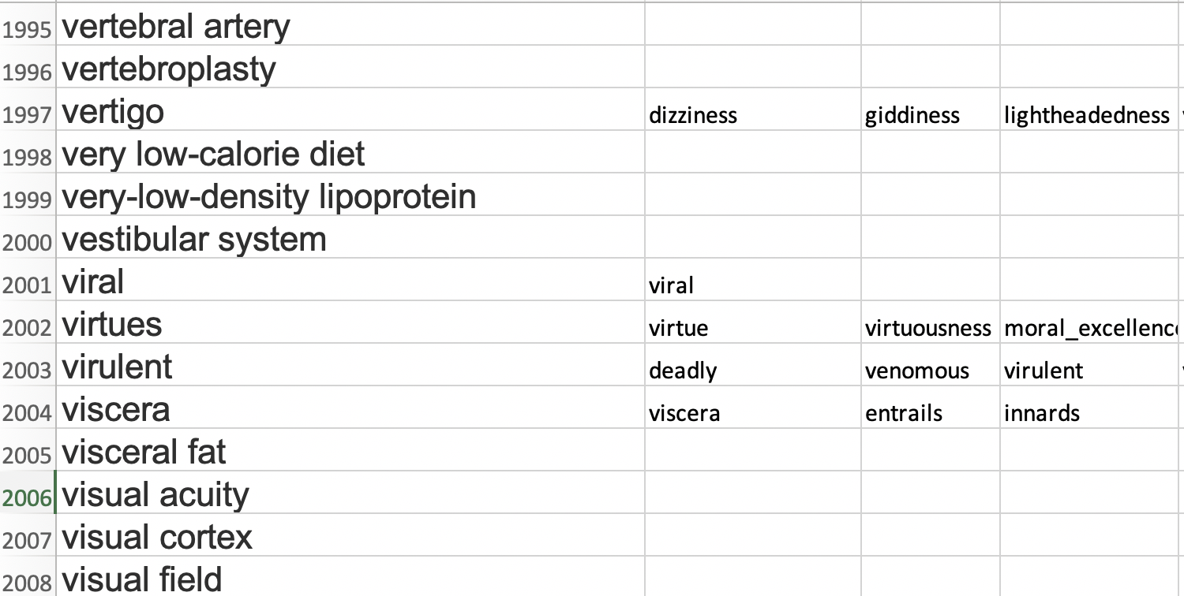
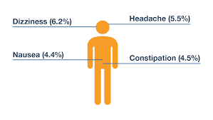
Bag of side effects and synonyms
A bag of 2100 words related to medical conditions, symptoms and side effects were scraped from: https://www.health.harvard.edu/a-through-c
Further the bag was magnified to 3448 unique key-words to include synonyms using synsets from nltk:corpus.

Slide 11

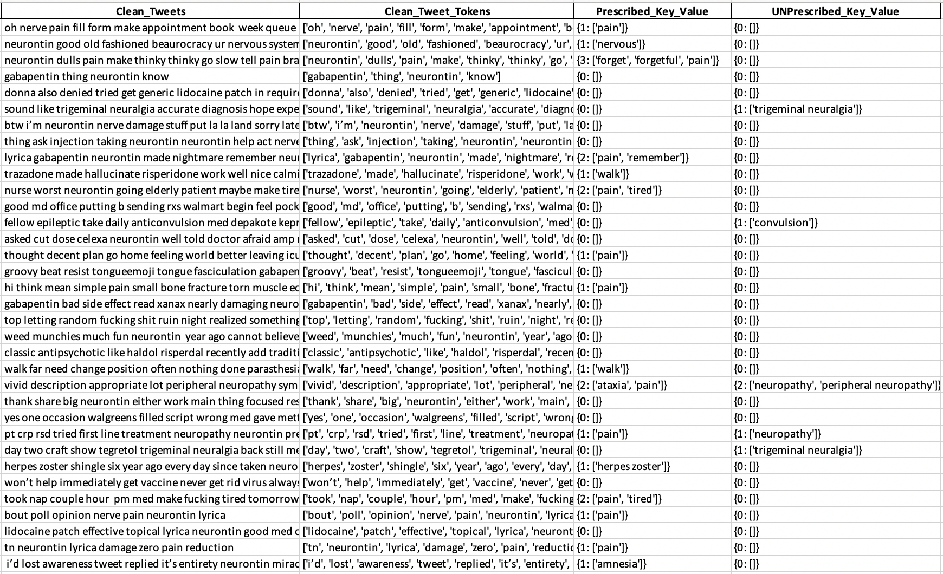
Search algorithm for identifying useful tweets
This algorithm compares the bag of side effects with the lemmatized tweets
It generates a word list as an output

Slide 12
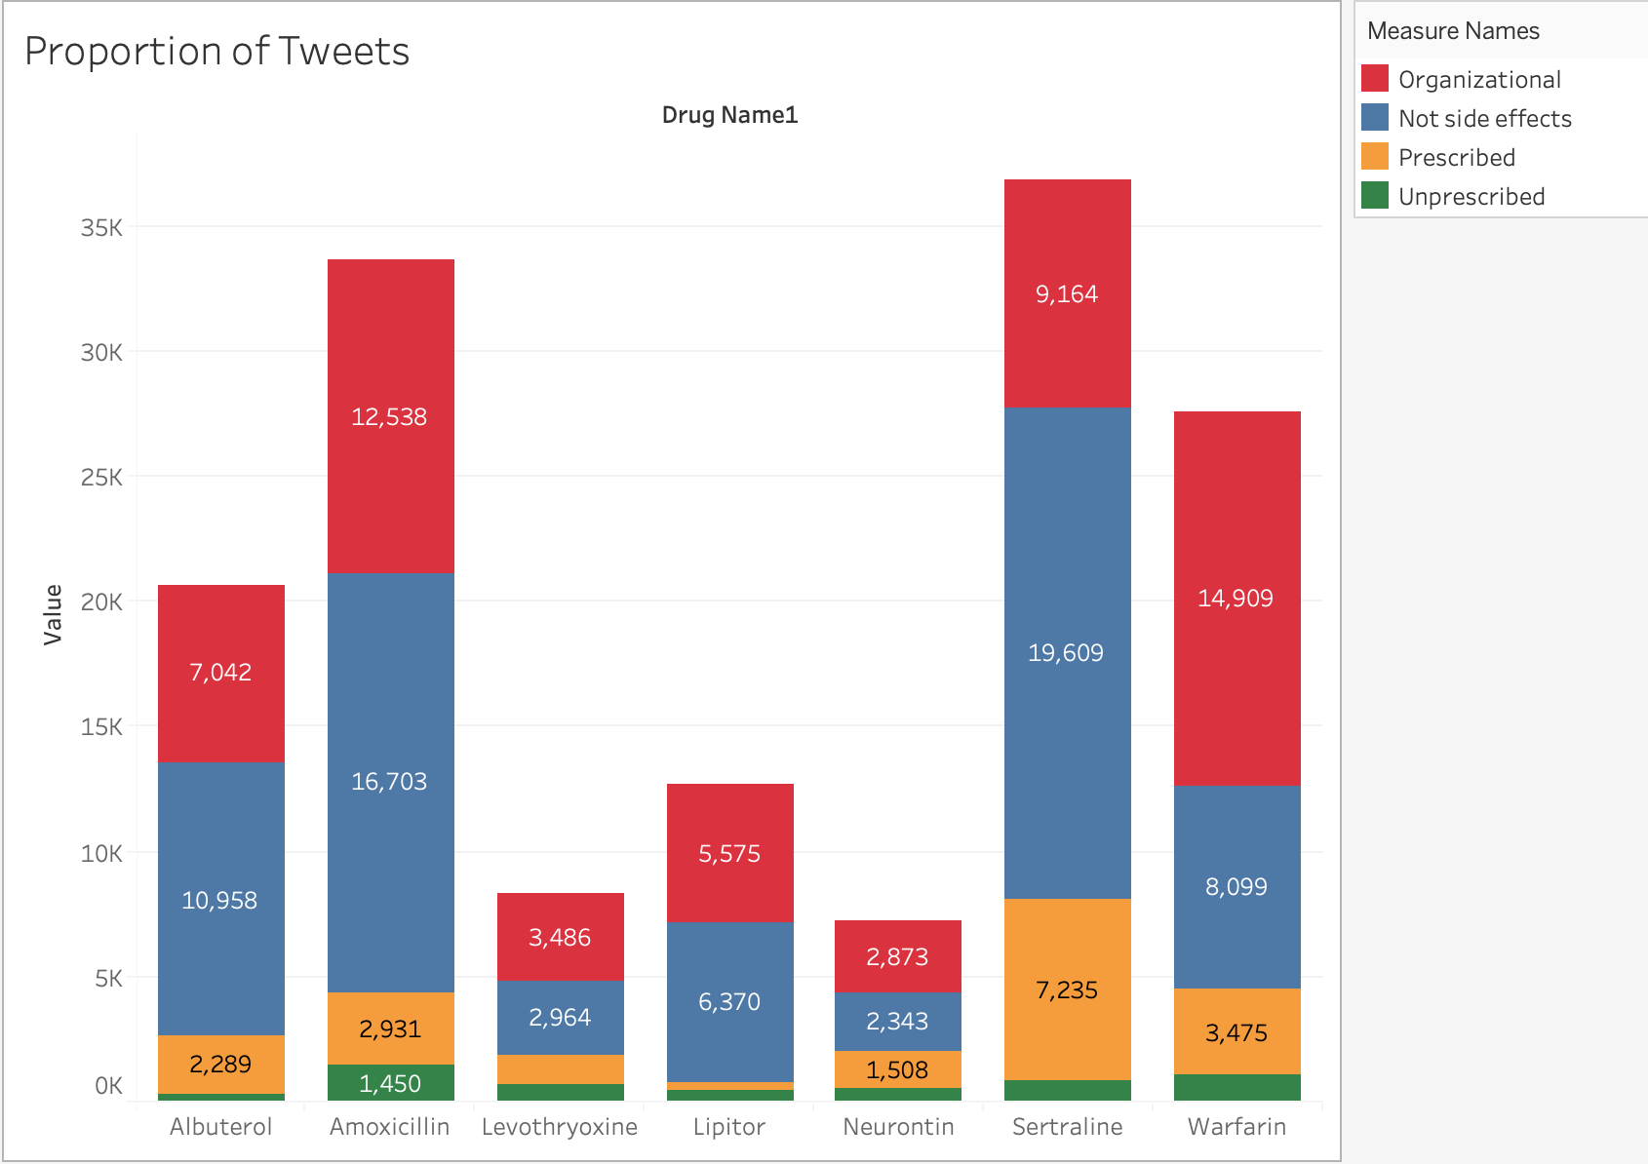

Slide 13
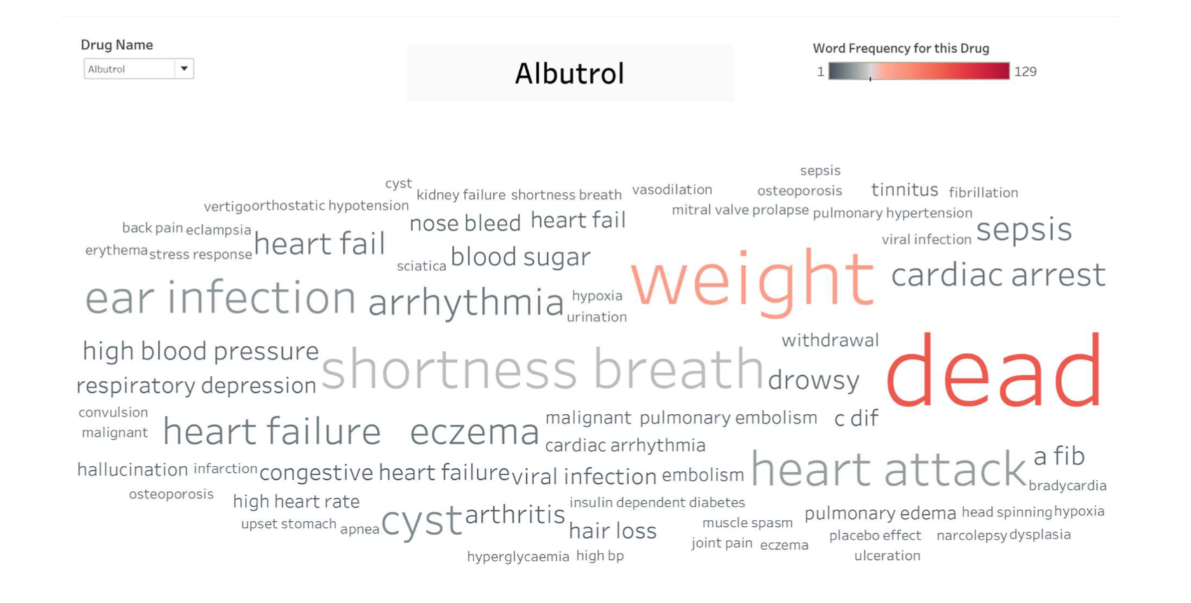
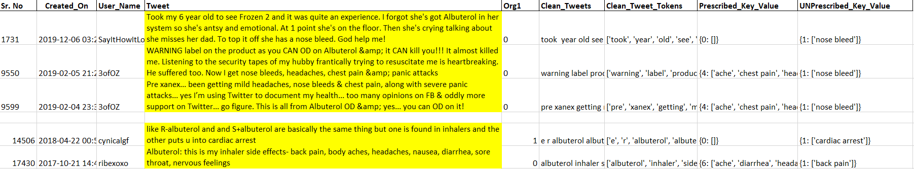
Unlisted Side Effects: Proportion and Side Effects
Albuterol

Slide 14
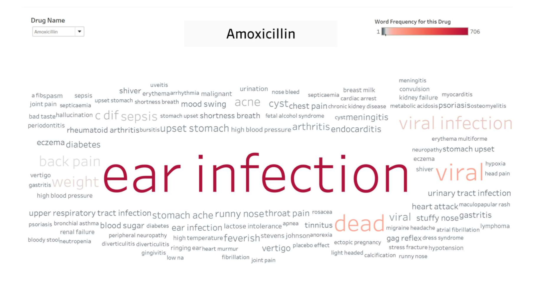
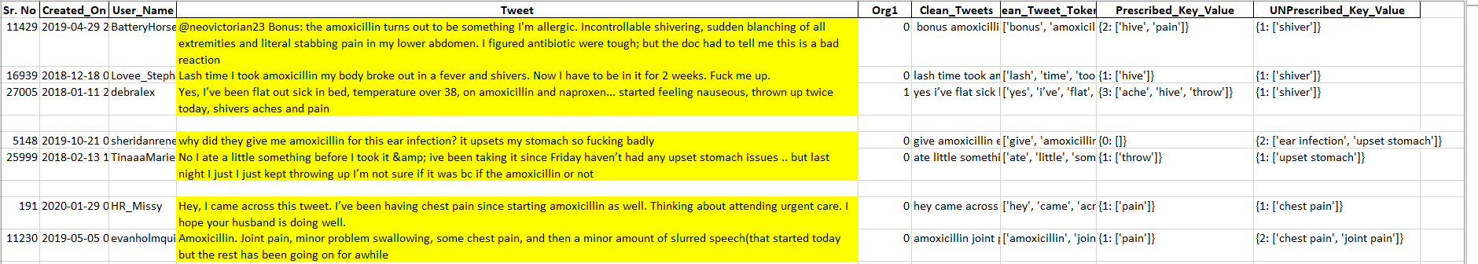
Amoxicillin

Slide 15
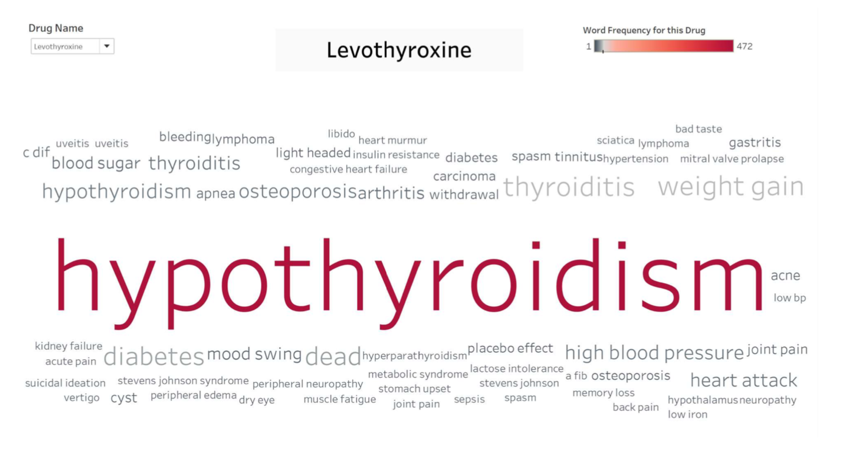
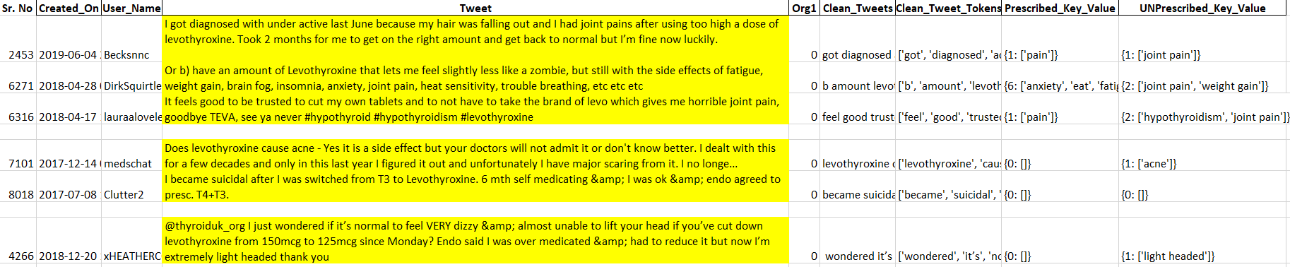
Levothyroxine

Slide 16
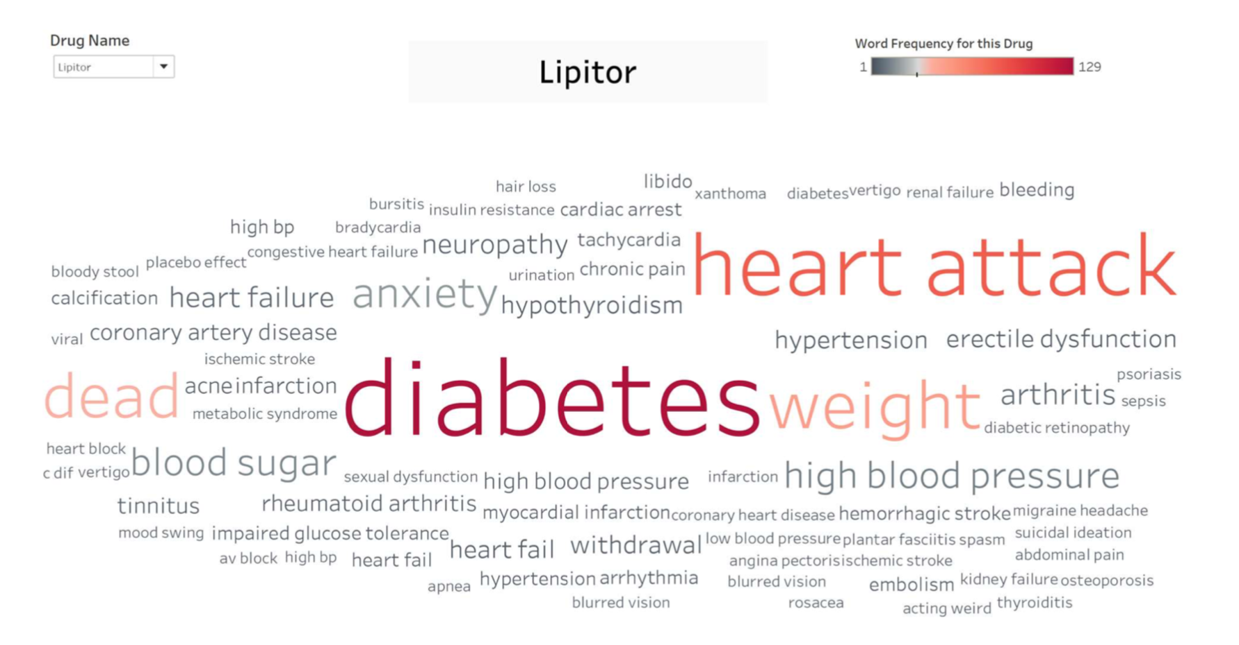
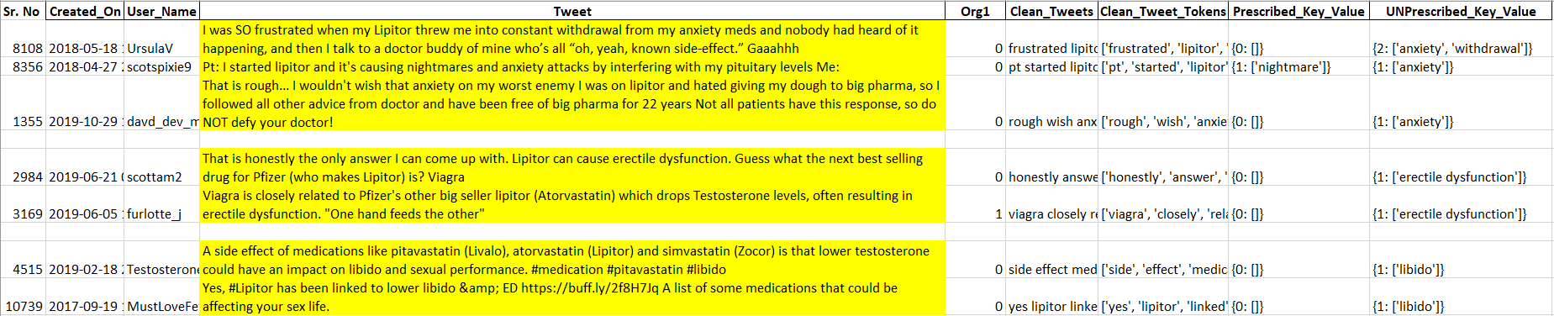
Lipitor

Slide 17
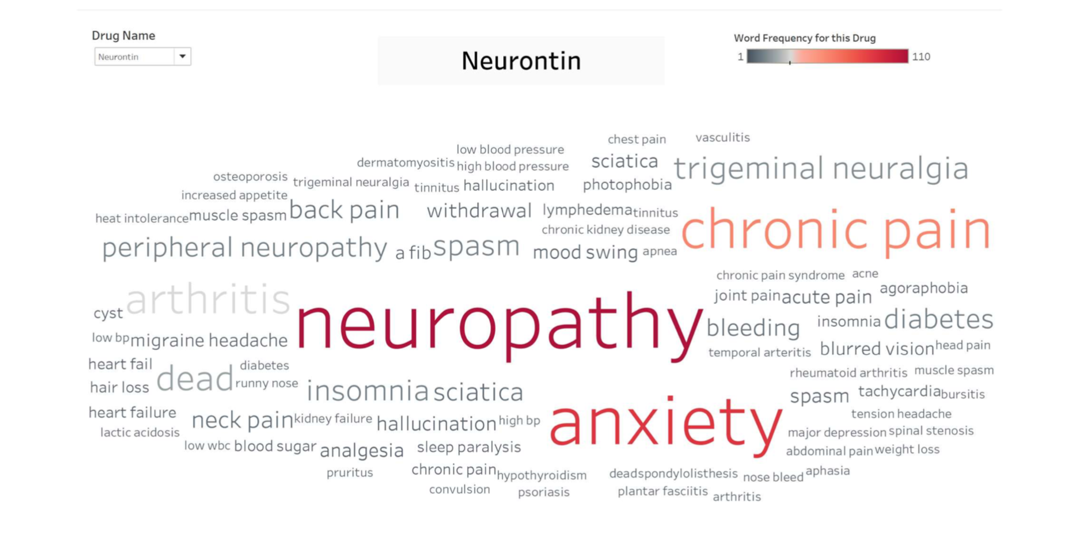
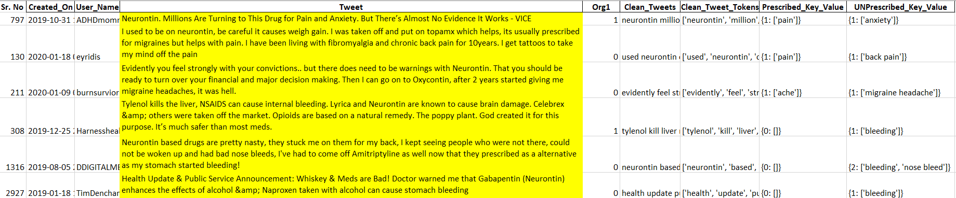
Neurontin

Slide 18
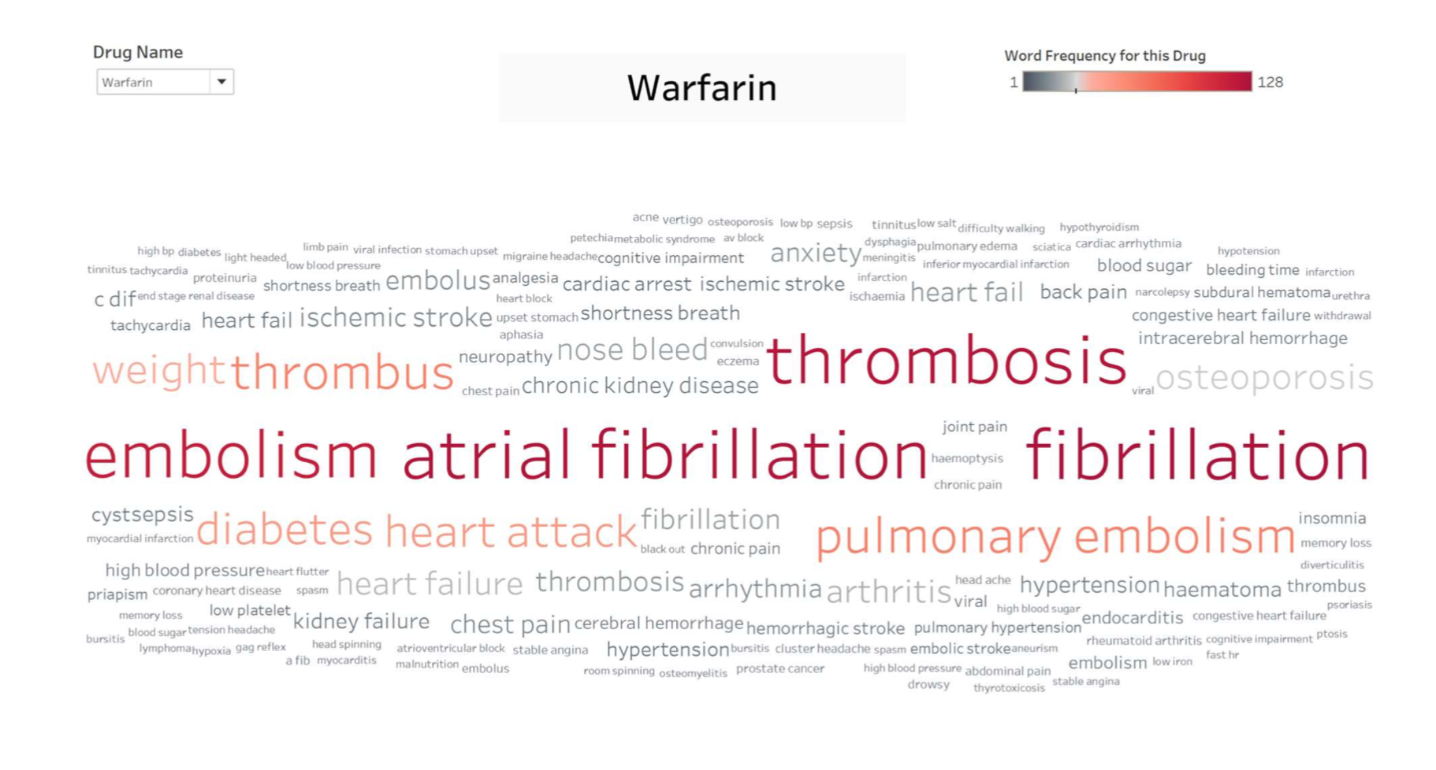
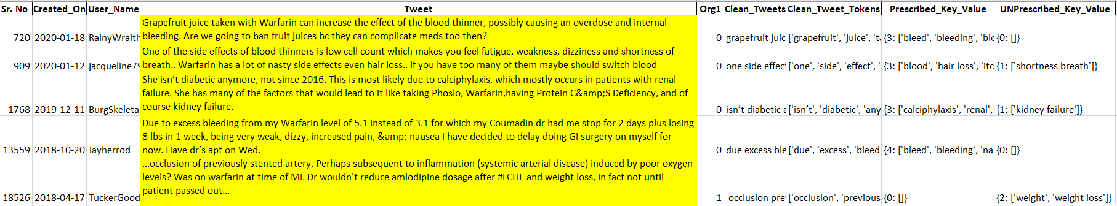
Warfarin

Slide 19
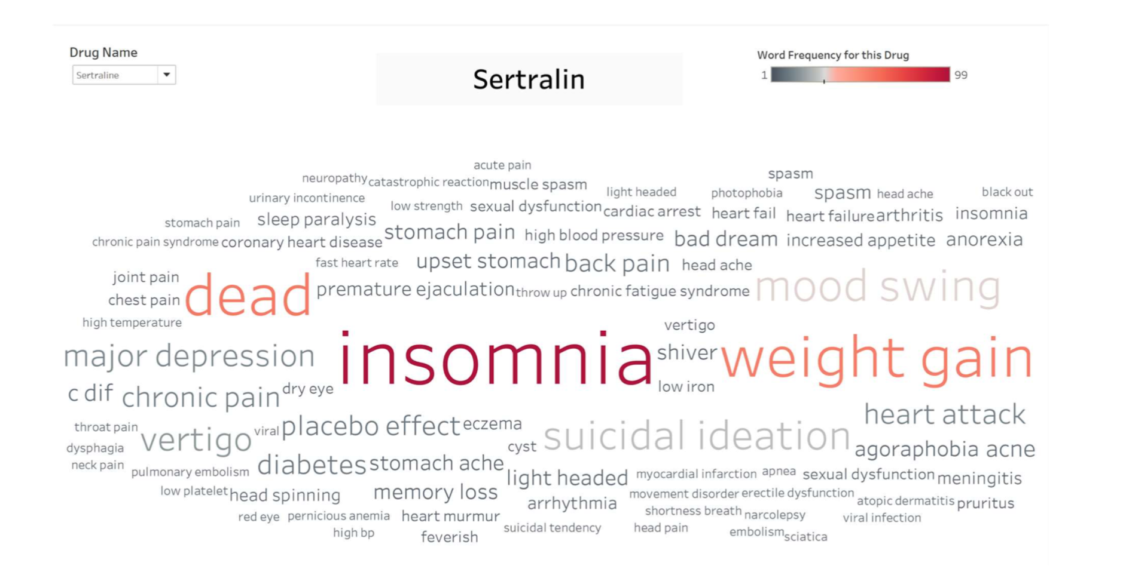
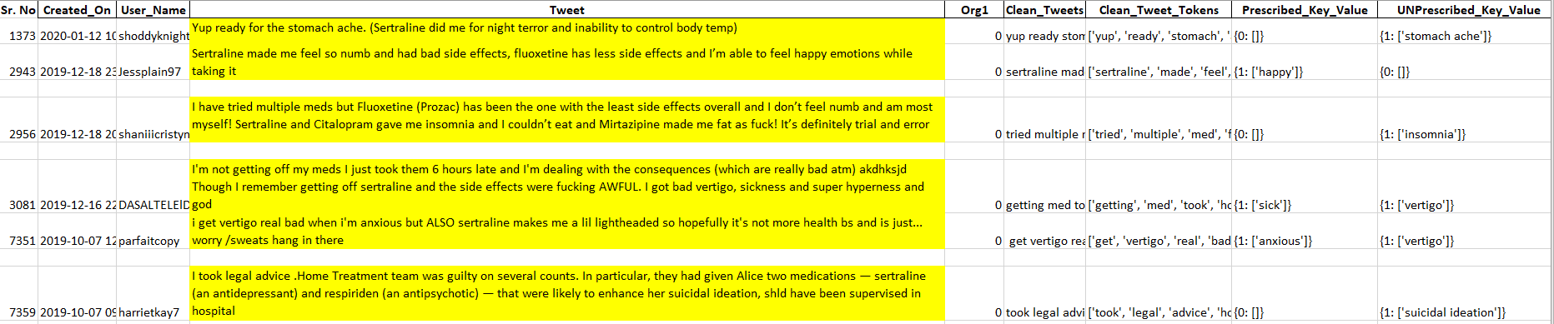
Sertraline

Slide 20

Thank You!

